Slide 1
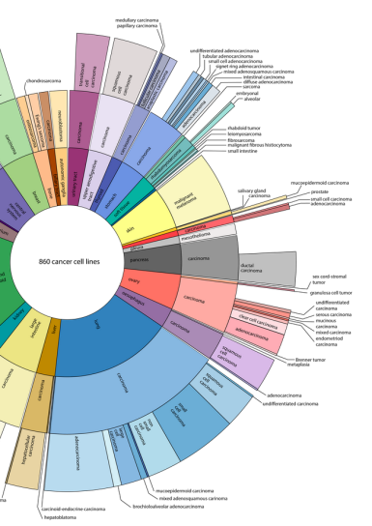
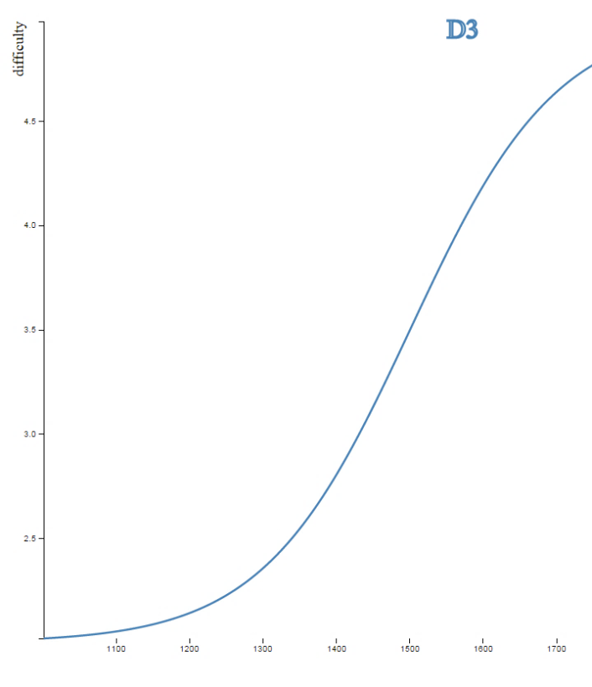

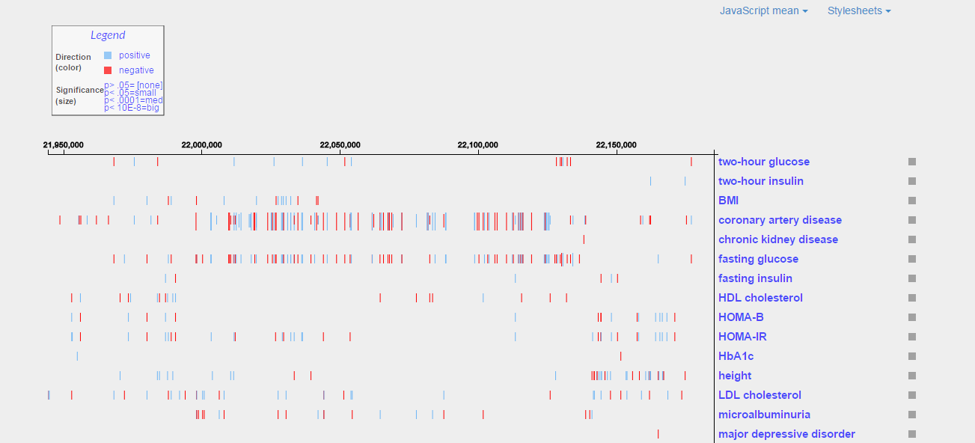

D3: scaling the learning curve and coding effectively

Slide 2
How I've organized this presentation:
Overview of the topic
Introduction to D3
Core JavaScript ideas
Advanced concepts
D3 in the real world
git@github.com:benralexander/intro-to-D3.git

Slide 3

http://vis.stanford.edu/papers/d3
-- 2011 --

Slide 4
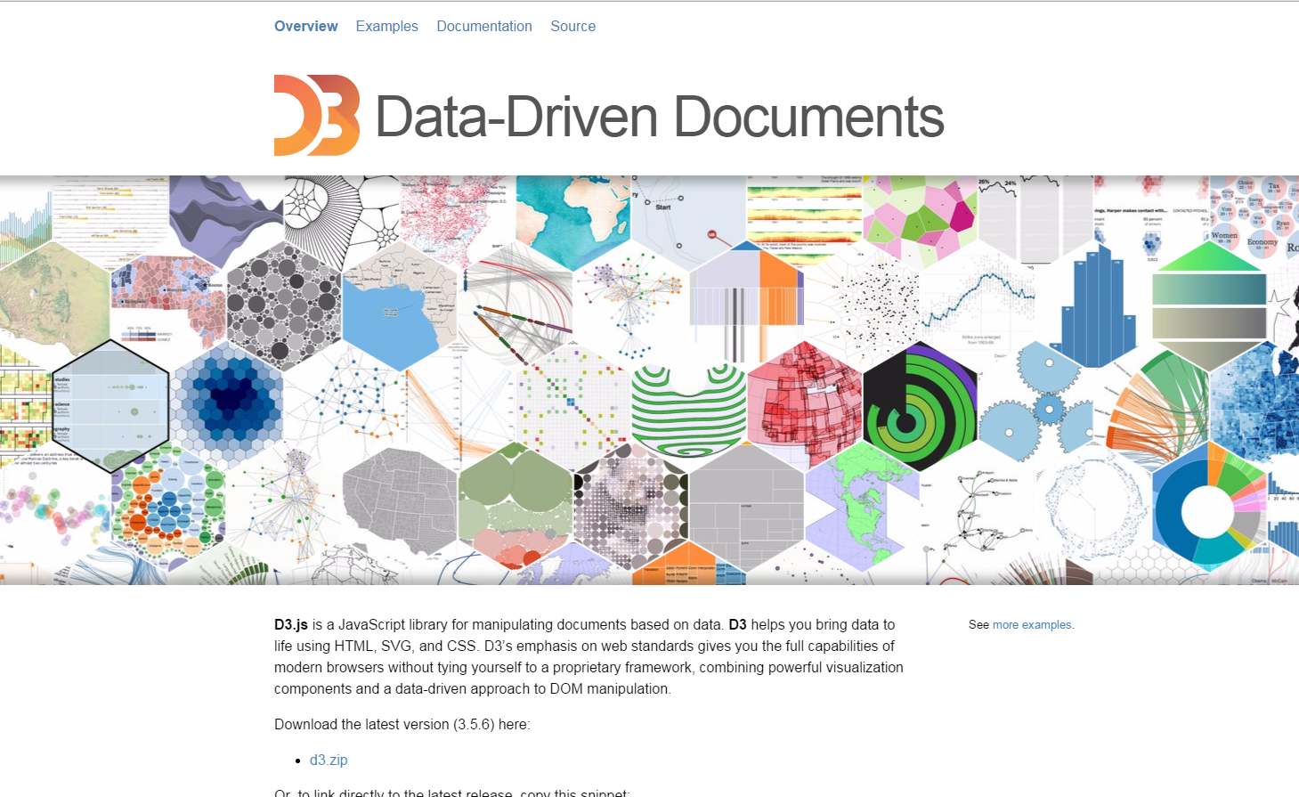
http://d3js.org/
-- 2015 --

Slide 5
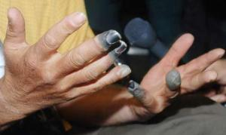
Frostbitten fingers, and
the right tool for the right job.

Slide 6

Frostbitten fingers

Slide 7

The right tool for the right job

Slide 8
Our job: extracting order from chaos
gatherdata
build tables
craft graphics
contemplate
design

Slide 9
Our job: extracting order from chaos
For the informaticist, "effort per byte" increases
gatherdata
build tables
craft graphics
contemplate
design
For the consumer, complexity decreases
(Or maybe, comprehension per unit time increases)

Slide 10

0 to 100 km/hr in 2.2 seconds

Slide 11
Introduction to D3
Notes:
If good programming is indeed an exercise in complexity minimization, how do we achieve that without the object orientation?

Slide 12
Data to knowledge conversion pipeline
HTML
CSS
Javascript
Data in DOM
expressed in SVG
Images/interactivity
in a browser
+
Knowledge
Raw data

Slide 13
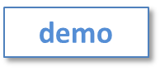
D3 can be hard to learn because it is not a language (though maybe a DSL). It is a JavaScript library which combines a collection of web development tools
Steep curves

Slide 14
Tools
HTML5
CSS3
DOM
SVG
Browser development environment

Slide 15
Tools
HTML5
CSS3
DOM
SVG
Browser development environment

Slide 16
Tools
HTML5
CSS3
DOM
SVG
Browser development environment

Slide 17
Tools
HTML5
CSS3
DOM
SVG
Browser development environment

Slide 18
Tools
HTML5
CSS3
DOM
SVG
Browser development environment
Sierpinski triangles

Slide 19
Tools
HTML5
CSS3
DOM
SVG
Browser development environment
Not required but strongly recommended:
JQuery, Jasmine, web dev. env.

Slide 20
simplest possible graphic
<body>
<svg>
<rect width="250" height="250">
</svg>
</body>
svg

Slide 21

simplest possible graphic
<body>
<svg>
<rect width="250" height="250">
</svg>
</body>
svg
result -->

Slide 22
simplest possible graphic
<body>
<svg>
<rect width="250" height="250">
</svg>
</body>
svg
result -->
<body>
<script>
d3.select('body')
.append('svg')
.append('rect')
.attr('height', 250)
.attr('width', 250);
</script>
</body>
D3

Slide 23
A slightly more complicated example
d3.select("body")
.selectAll("div.fee")
.data([4, 8, 15])
.enter()
.insert("div")
.attr('class','fee')
.text(function(d) { return ""+d; });
D3

Slide 24
The data types from each call
d3.select("body") <-- returns "selection"
.selectAll("div.fee") <-- returns "selection"
.data([4, 8, 15]) <-- returns "update selection"
.enter() <-- returns "enter selection"
.insert("div") <-- returns "selection"
.attr('class','fee') <-- returns "selection"
.text(function(d) { return ""+d; }); <-- returns "selection"

Slide 25
The data types from each call
d3.select("body") <-- returns "selection"
.selectAll("div.fee") <-- returns "selection"
.data([4, 8, 15]) <-- returns "update selection"
.enter() <-- returns "enter selection"
.insert("div") <-- returns "selection"
.attr('class','fee') <-- returns "selection"
.text(function(d) { return ""+d; }); <-- returns "selection"
Returns a real DOM element to which we can anchor everything else

Slide 26
The data types from each call
d3.select("body") <-- returns "selection"
.selectAll("div.fee") <-- returns "selection"
.data([4, 8, 15]) <-- returns "update selection"
.enter() <-- returns "enter selection"
.insert("div") <-- returns "selection"
.attr('class','fee') <-- returns "selection"
.text(function(d) { return ""+d; }); <-- returns "selection"
Returns an empty selector (containing no elements) but which can be used to create an update selector

Slide 27
The data types from each call
d3.select("body") <-- returns "selection"
.selectAll("div.fee") <-- returns "selection"
.data([4, 8, 15]) <-- returns "update selection"
.enter() <-- returns "enter selection"
.insert("div") <-- returns "selection"
.attr('class','fee') <-- returns "selection"
.text(function(d) { return ""+d; }); <-- returns "selection"
Joins the data array to the existing selection. The resulting update selector contains references to both the enter and the exit operator

Slide 28
The data types from each call
d3.select("body") <-- returns "selection"
.selectAll("div.fee") <-- returns "selection"
.data([4, 8, 15]) <-- returns "update selection"
.enter() <-- returns "enter selection"
.insert("div") <-- returns "selection"
.attr('class','fee') <-- returns "selection"
.text(function(d) { return ""+d; }); <-- returns "selection"
Returns and enter selector, with placeholder nodes for every data element for which no corresponding DOM element was found. The enter method is only available on an update selector. The enter selector defines only append, insert, select, and call operators.

Slide 29
The data types from each call
d3.select("body") <-- returns "selection"
.selectAll("div.fee") <-- returns "selection"
.data([4, 8, 15]) <-- returns "update selection"
.enter() <-- returns "enter selection"
.insert("div") <-- returns "selection"
.attr('class','fee') <-- returns "selection"
.text(function(d) { return ""+d; }); <-- returns "selection"
Instantiates the entering element, creating a node in the DOM that can then be modified by subsequent operators.

Slide 30
The data types from each call
d3.select("body") <-- returns "selection"
.selectAll("div.fee") <-- returns "selection"
.data([4, 8, 15]) <-- returns "update selection"
.enter() <-- returns "enter selection"
.insert("div") <-- returns "selection"
.attr('class','fee') <-- returns "selection"
.text(function(d) { return ""+d; }); <-- returns "selection"
Modifies the DOM element created in the last operation, appending a new attribute, and then passing back a pointer to the selection. Note the pattern of adding a class to match the original selectAll call.

Slide 31
The data types from each call
d3.select("body") <-- returns "selection"
.selectAll("div.fee") <-- returns "selection"
.data([4, 8, 15]) <-- returns "update selection"
.enter() <-- returns "enter selection"
.insert("div") <-- returns "selection"
.attr('class','fee') <-- returns "selection"
.text(function(d) { return ""+d; }); <-- returns "selection"
Replaced all existing text elements on the current selection, then returns a pointer to that selection.

Slide 32
A slightly more complicated example
d3.select("body")
.selectAll("div.fee")
.data([4, 8, 15])
.enter()
.insert("div")
.attr('class','fee')
.text(function(d) { return ""+d; });
D3

Slide 33
A slightly more complicated example
d3.select("body")
.selectAll("div.fee")
.data([4, 8, 15])
.enter()
.insert("div")
.attr('class','fee')
.text(function(d) { return ""+d; });
D3
result -->
4
8
15

Slide 34
A slightly more complicated example
d3.select("body")
.selectAll("div.fee")
.data([4, 8, 15])
.enter()
.insert("div")
.attr('class','fee')
.text(function(d) { return ""+d; });
D3
result -->
4
8
15
<body>
<div class="fee">4</div>
<div class="fee">8</div>
<div class="fee">15</div>
</body>
html

Slide 35
Motivational graphics
terrestrial map
celestial map

Slide 36
Storing data in the DOM
var upd=d3.select("body")
.selectAll("circle")
.data([6,8]);
upd.attr('class',function(d){
console.log('old'+d)
});
upd.enter()
.append("circle")
.attr('class',function(d){
console.log('new'+d)
});
upd.attr('class',function(d){
console.log('old and new'+d);
})
upd.exit().remove()

Slide 37
JS to explore enter, update, exit
var tools= (function(){
var holder, // private variable
updSel=function(data){ // generate an 'update' selector
holder=d3.select("body").selectAll("circle").data(data);
console.log('stored array -> '+data);
},
updOverlap=function(){ // examine data we stored
var overlap=[];
holder.attr('class',function(d){overlap.push(d)});
console.log('overlap -> '+overlap);
},
updNew=function(){ // generate 'enter' selector, use it to append to DOM
var newstf=[];
holder.enter().append("circle").attr('class',function(d){newstf.push(d)});
console.log('newstf -> '+newstf);
},
updEverything=function(){ // data resulting after using the 'enter' selector
var everything=[];
holder.attr('class',function(d){everything.push(d)})
console.log('everything -> '+everything);
},
updExit=function(){ // generate 'exit' selector
holder.exit().remove()
};
return { // make methods publicly available
updSel:updSel,
updOverlap:updOverlap,
updNew:updNew,
updEverything:updEverything,
updExit:updExit
}
})();

Slide 38
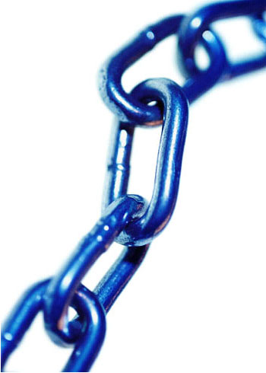
D3 patterns– method chaining (1/2)
A commonly used pattern in D3 involves returning a consistent object with each call so that methods can be chained
svg.selectAll(‘circle’)
.attr(‘cx’, 50)
.attr(‘cy’, 100)
.attr(‘r’, 3.5);
A JavaScript pattern makes this construction easy to implement…
Notes:
Use Sierpinski example here?

Slide 39
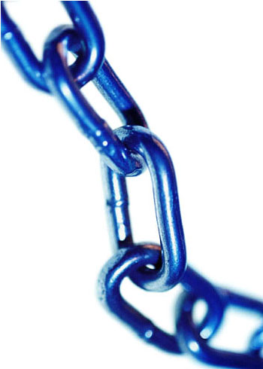
D3 patterns– method chaining (2/2)
JavaScript implementation:
instance.width = function (x) {
if (!arguments.length) return width;
width = x;
return instance;
};
Note also that this pattern combines
getters and setters into a single function
Notes:
Use Sierpinski example here?

Slide 40
D3 patterns- charts as closures
Combine the method chaining slides into one example
function myChart(){
function instance () {
// chart generation code goes here
}
instance.width = function (x) {
if (!arguments.length) return whiskers;
whiskers = x;
return instance;
};
return instance;
}
Notes:
Use Sierpinski example here?

Slide 41
The elements most D3 graphics need:
Scales: d3.scale()
https://github.com/mbostock/d3/wiki/API-Reference#d3scale-scales
Axes: d3.svg.axis()
https://github.com/mbostock/d3/wiki/SVG-Axes
Data: d3.csv()
https://github.com/mbostock/d3/wiki/CSV
and of course Enter/Update/Exit
Notes:
If good programming is indeed an exercise in complexity minimization, how do we achieve that without the object orientation?

Slide 42
Real-world graphics
Manhattan plot

Slide 43

Core JavaScript concepts
Notes:
If good programming is indeed an exercise in complexity minimization, how do we achieve that without the object orientation?

Slide 44
Javascript
Javascript is dynamic, (executing many behaviors at runtime) prototype-based (as opposed to class inheritance) scripting language with first-class functions (functions have properties and methods, can be nested, and support lexical closures). Early versions of the JavaScript have been available since 1996.
Notes:
If good programming is indeed an exercise in complexity minimization, how do we achieve that without the object orientation?

Slide 45
Encapsulation: remember that Javascript is NOT block scoped
x;
==> undefined
{
var x = 1;
}
x;
==> 1
Notes:
also not that VAR keeps away the globals

Slide 46
Encapsulation: remember that Javascript is NOT block scoped
x;
==> undefined
{
var x = 1;
}
x;
==> 1
Notes:
also not that VAR keeps away the globals

Slide 47
Encapsulation: remember that Javascript is NOT block scoped
x;
==> undefined
{
var x = 1;
}
x;
==> 1
Notes:
also not that VAR keeps away the globals

Slide 48
Encapsulation: keep your namespaces clean
var cbbo = {}; // not safe
cbbo.myVar = 123;
if ( typeof cbbo === "undefined") {
cbbo = {}; // not succinct
}
var cbbo = cbbo || {}; // Nice!

Slide 49
Encapsulation: keep your namespaces clean
var cbbo = {}; // not safe
cbbo.myVar = 123;
if ( typeof cbbo === "undefined") {
cbbo = {}; // not succinct
}
var cbbo = cbbo || {}; // Nice!

Slide 50
Encapsulation: keep your namespaces clean
var cbbo = {}; // not safe
cbbo.myVar = 123;
if ( typeof cbbo === "undefined") {
cbbo = {}; // not succinct
}
var cbbo = cbbo || {}; // Nice!

Slide 51
Encapsulation: immediately invoked function declarations are your friend
console.log('x1='+typeof x);
(function(){
var x=47;
console.log('y1='+typeof x);
})();
console.log('x2='+typeof x);

Slide 52
Encapsulation: immediately invoked function declarations are your friend
console.log('x1='+typeof x);
(function(){
var x=47;
console.log('y1='+typeof x);
})();
console.log('x2='+typeof x);

Slide 53
Encapsulation: immediately invoked function declarations are your friend
console.log('x1='+typeof x);
(function(){
var x=47;
console.log('y1='+typeof x);
})();
console.log('x2='+typeof x);

Slide 54

Encapsulation: favor assignment of anonymous functions
x(); // ERROR -- x is declared but still undefined
y(); // y can run before it is declared
var x=function(){
console.log('here I am x');
};
function y(){
console.log('here I am y');
};

Slide 55
Encapsulation: favor assignment of anonymous functions
x(); // ERROR -- x is declared but still undefined
y(); // y can run before it is declared
var x=function(){
console.log('here I am x');
};
function y(){
console.log('here I am y');
};

Slide 56
Encapsulation: favor assignment of anonymous functions
x(); // ERROR -- x is declared but still undefined
y(); // y can run before it is declared
var x=function(){
console.log('here I am x');
};
function y(){
console.log('here I am y');
};

Slide 57
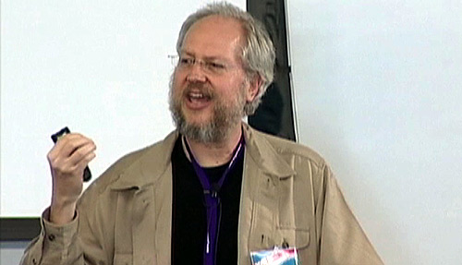
The ‘Crockford Effect’
Douglas Crockford wrote a hugely influential book in 2008:
“Most programming languages contain good and bad parts, but JavaScript has more than its share of the bad … This authoritative book scrapes away these bad features to reveal a subset of JavaScript that's more reliable, readable, and maintainable than the language as a whole…”
He also went on to write JSLint to codify and enforce his ideas. His approach is workable and self consistent, it isn’t the only way to write good JavaScript.

Slide 58
Advanced concepts
Linked hierarchies visualization
(backup)
Notes:
If good programming is indeed an exercise in complexity minimization, how do we achieve that without the object orientation?

Slide 59
In D3, favor call to execute functions
//
// A function I want to call elsewhere.
// Note that it takes a selection as a param
//
var myFun = function (sel) {
sel.attr('class','mmyNewClass');
};
// works, but not as nice
myFun(d3.select('body'));
// cleaner. Well-suited for
// function chaining. Note that
// the selection parameter is implicit
d3.select('body').call(myFun);

Slide 60
In D3, favor call to execute functions
//
// A function I want to call elsewhere.
// Note that it takes a selection as a param
//
var myFun = function (sel) {
sel.attr('class','mmyNewClass');
};
// works, but not as nice
myFun(d3.select('body'));
// cleaner. Well-suited for
// function chaining. Note that
// the selection parameter is implicit
d3.select('body').call(myFun);

Slide 61
In D3, favor call to execute functions
//
// A function I want to call elsewhere.
// Note that it takes a selection as a param
//
var myFun = function (sel) {
sel.attr('class','mmyNewClass');
};
// works, but not as nice
myFun(d3.select('body'));
// cleaner. Well-suited for
// function chaining. Note that
// the selection parameter is implicit
d3.select('body').call(myFun);

Slide 62
JavaScript's call is different
var xx=function(myParm){
console.log('this='+this+',myParm='+
myParm);
}
xx('f')
this=[object Window], myParm=f
xx.call('g','f')
this=g, myParm=f
Notes:
Functions have built-in call method for custom receivers:
Under ES5 every function has a “bind” method which provide a way to assign a custom receiver across one or more calls. Useful when currying and in other applications.

Slide 63
JavaScript's call is different
var xx=function(myParm){
console.log('this='+this+',myParm='+
myParm);
}
xx('f')
this=[object Window], myParm=f
xx.call('g','f')
this=g, myParm=f
Notes:
Functions have built-in call method for custom receivers:
Under ES5 every function has a “bind” method which provide a way to assign a custom receiver across one or more calls. Useful when currying and in other applications.

Slide 64
JavaScript's call is different
var xx=function(myParm){
console.log('this='+this+',myParm='+
myParm);
}
xx('f')
this=[object Window], myParm=f
xx.call('g','f')
this=g, myParm=f
Notes:
Functions have built-in call method for custom receivers:
Under ES5 every function has a “bind” method which provide a way to assign a custom receiver across one or more calls. Useful when currying and in other applications.

Slide 65
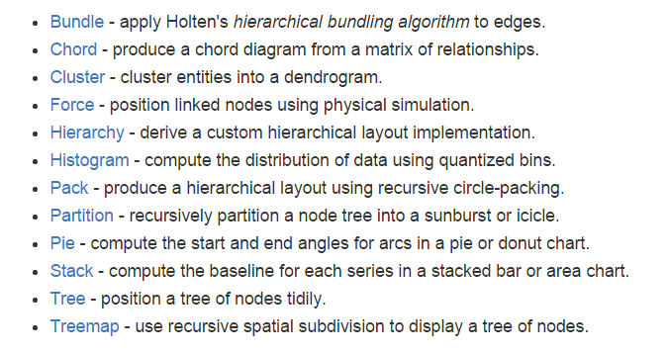
D3’s Layouts provide flexibility

Slide 66
In D3, look for opportunities to nest
var myVar = d3.nest()
.key(function(d) {
return d.ID;
})
.sortKeys(function(a,b) {
return a.POS - b.POS;
})
.rollup(function(d) {
return d[0].DBSNP_ID;
})
.entries(dd)
.map(function(d){
return {'id':d.key,
'rs':d.values}
});

Slide 67
In D3, look for opportunities to nest
var myVar = d3.nest()
.key(function(d) {
return d.ID;
})
.sortKeys(function(a,b) {
return a.POS - b.POS;
})
.rollup(function(d) {
return d[0].DBSNP_ID;
})
.entries(dd)
.map(function(d){
return {'id':d.key,
'rs':d.values}
});

Slide 68
In D3, look for opportunities to nest
var myVar = d3.nest()
.key(function(d) {
return d.ID;
})
.sortKeys(function(a,b) {
return a.POS - b.POS;
})
.rollup(function(d) {
return d[0].DBSNP_ID;
})
.entries(dd)
.map(function(d){
return {'id':d.key,
'rs':d.values}
});

Slide 69
In D3, look for opportunities to nest
var myVar = d3.nest()
.key(function(d) {
return d.ID;
})
.sortKeys(function(a,b) {
return a.POS - b.POS;
})
.rollup(function(d) {
return d[0].DBSNP_ID;
})
.entries(dd)
.map(function(d){
return {'id':d.key,
'rs':d.values}
});

Slide 70
Patterns: Looping in Javascript
Iterators are generally better than looping.
var dict=[{ name:joe, age:22},
{ name:bob, age:23}];
var justNames = [];
dict.forEach( function(x) {
justNames.push(x.name);
}
Though under ES5 maps are the best way to modify arrays.
var nameSlashAge = dict.map(function(x) {
return x.name+’/’+ x.age;
})
Notes:
Under ES5 every function has a “bind” method which provide a way to assign a custom receiver across one or more calls. Useful when currying and in other applications.

Slide 71
Patterns: Looping in Javascript
Iterators are generally better than looping.
var dict=[{ name:joe, age:22},
{ name:bob, age:23}];
var justNames = [];
dict.forEach( function(x) {
justNames.push(x.name);
}
Though under ECMA5 prefer maps to modify arrays.
var nameSlashAge = dict.map(function(x) {
return x.name+’/’+ x.age;
})
Notes:
Under ES5 every function has a “bind” method which provide a way to assign a custom receiver across one or more calls. Useful when currying and in other applications.

Slide 72
Patterns no more
A nice graphic in principle
Notes:
Under ES5 every function has a “bind” method which provide a way to assign a custom receiver across one or more calls. Useful when currying and in other applications.

Slide 73
JavaScript Patterns
Stephan Stefanov’s ‘module pattern’. Good for building libraries.
var u3=(function(){
var _myParm,
setParm=function(myParm){
_myParm=myParm;
},
getParm=function(){
return "your parm is "+_myParm;
};
return {
setParm:setParm,
getParm:getParm
}
}());
Notes:
but probably not a good way to build reusable objects

Slide 74
D3 in the real world
It's only a bar chart
Notes:
If good programming is indeed an exercise in complexity minimization, how do we achieve that without the object orientation?

Slide 75
JavaScript timeline
1996: JavaScript created by Brendan Eich for Netscape Navigator
1997: JavaScript begins standardization process
1998
1999: Reg ex, better string handling, try/catch, etc
2000: JavaScript becomes important enough to fight over
2011: ECMA 5 standard released

Slide 76
Browser compatibility
Google Chrome
OK
Firefox
Opera
Internet Explorer (v10 & v11)
Microsoft Edge?
X
Safari for Windows
Internet Explorer (<v.10)

Slide 77
Publishing D3 graphics
Publication quality graphics are easy to generate:
Create your target graphic in a browser
Open your browser development environment, and capture the SVG code
Paste the SVG into a standalone file
If necessary, you can open the SVG with a suitable editing program ( I use Adobe Illustrator) and polish your graphic
Sunburst MLP graphic
Refined CCL graphic

Slide 78
Standard software engineering best practices
Use a source control repo (GitHub is great), with lots of branching and committing
Use a 'make' system (I use Gradle as a part of Grails. Grunt is also quite popular)
Incorporate testing into your development cycle (Jasmine is one option, but there are many others)
Maintain a bug database
Iterate frequently to try out your new ideas (Bostock motivates iteration this way "design is a search process")

Slide 79
Looking for ideas...
Flawed presentation of SNPs over a genomic range

Slide 80
Acknowledgments
Medical population genetics
Other people who've helped
David Altshuler
Jose Florez
Jason Flannick
Kaan Yuksel
Marcin von Grotthuss
Marc Duby
Oliver Ruebenacker
Todd Green
Jason Wright
Bang Wong
Noam Shoresh
Maskull Lasserre
Dong-keun Jong
Notes:
Use Sierpinski example here?

Slide 81
Books worth having:
Data-Driven Documents, M. Bostock, et. al. IEEE Trans. Visualization and Comp. Graphics (Proc. InfoVis) 2011
Effective JavaScript, David Herman.2013, Person Education
JavaScript: The Good Parts, Douglas Crockford,2008, O’Reilly
JavaScript Patterns, Stoyan Stefanov,2010, O’Reilly
The Grammer of Graphics, Leland Wilkinson,2005, Springer Science
D3.js in action, Elijah Meeks, 2015, Manning Publications Co.
Notes:
Under ES5 every function has a “bind” method which provide a way to assign a custom receiver across one or more calls. Useful when currying and in other applications.

Slide 82
References from this talk
git@github.com:benralexander/intro-to-D3.git
http://graphicscow.org
http://www.bagetsoftware.org
http://bovinecontemplation.org
Notes:
Under ES5 every function has a “bind” method which provide a way to assign a custom receiver across one or more calls. Useful when currying and in other applications.

